Slide 1

Data Analyst case study 2023 Generating insights to aid property investment decision Akanbi Taofik. August 2023

Slide 2

TABLE OF CONTENTS
Introduction
Business Objective
Data Overview
Data Quality
Analysis
Actionable Insights
Recommendations
Limitations

Slide 3

Business Objective
The main objective of this task is to evaluate property and short let apartment market in NY to determine which areas/properties are best for the company to invest in (by purchasing property to rent out).

Slide 4

Brief Introduction Data Overview Data quality check

Slide 5
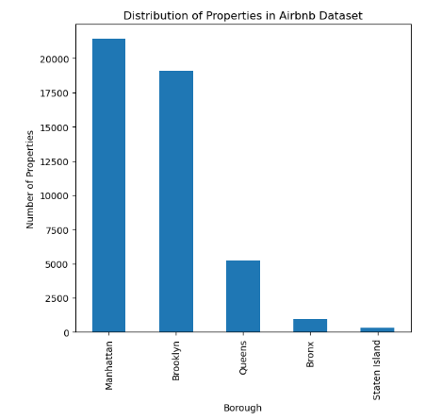
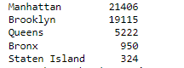
Distribution of Airbnb Listings per Borough
More Airbnb listings in Manhattan and Brooklyn compared to the other Boroughs

Slide 6
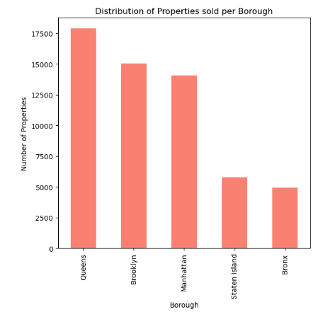
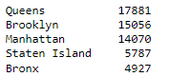
Distribution of Property sold per Borough
More properties sold in Queens and Brooklyn compared to other Boroughs

Slide 7
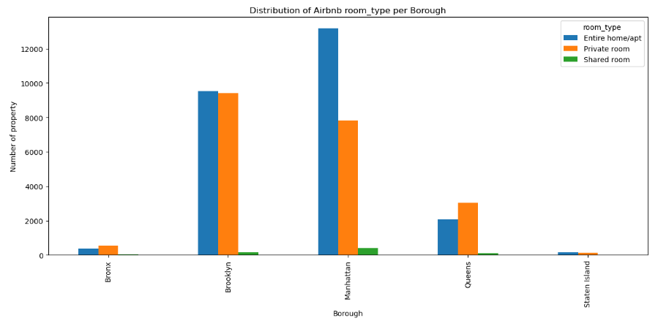
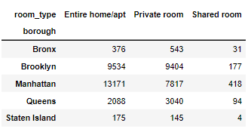
Distribution of Airbnb room type per Borough
Entire room/apt and private room has more listings across the different boroughs

Slide 8
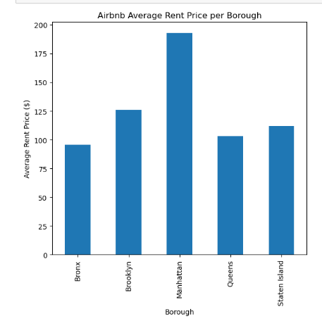
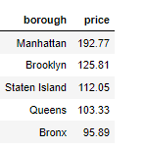
Airbnb Average Rent Price Per Borough
Higher Airbnb average rent price in Manhattan and Brooklyn compared to other boroughs
Manhattan and Brooklyn are preferable location for tourist and business travellers

Slide 9
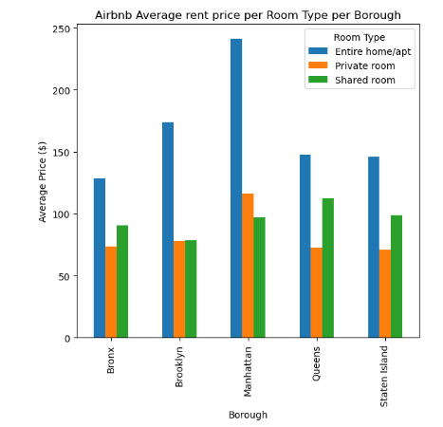
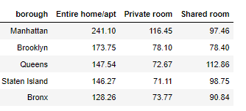
Airbnb Average Rent Price Per Room Type per Borough
Entire home have the highest average prices across all boroughs, and they are in higher demands.

Slide 10
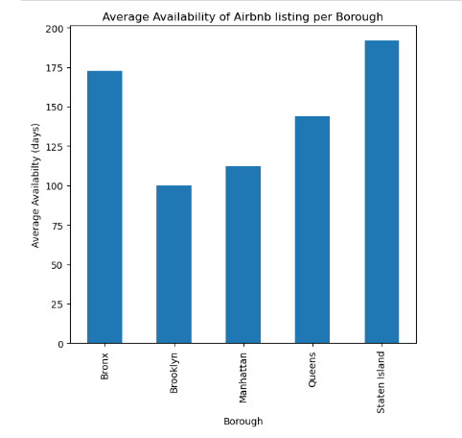
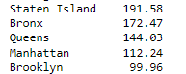
Average Airbnb Listing Availability Per Borough
Less Airbnb availability for listings in Manhattan and Brooklyn meaning they are in higher demands, and they are the preferred locations.

Slide 11
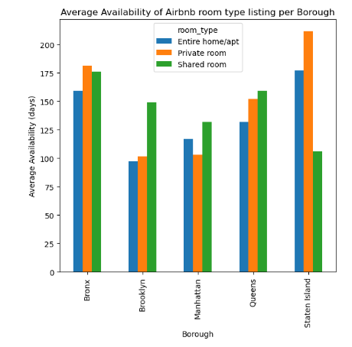
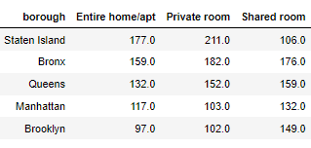
Average Availability of Airbnb Room Type Per Borough
Entire home/apt and private rooms has lowest availability across the boroughs meaning they are in high demands and are always booked.

Slide 12
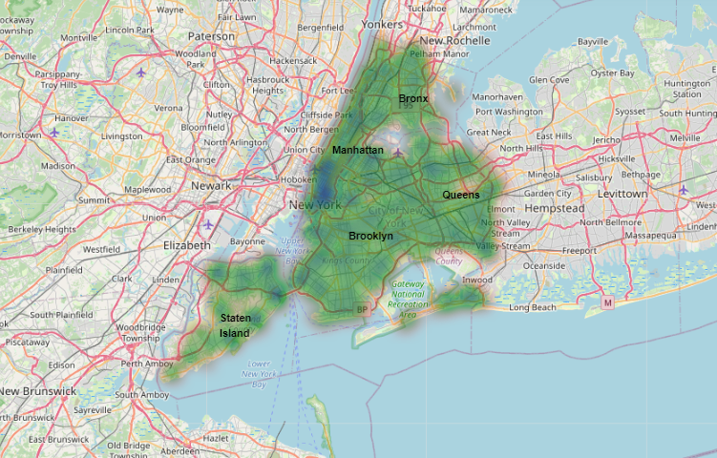
Geographical impact on Borough performance
Geographical advantage for Manhattan and Brooklyn as they are in the central location of New York. Hence high demands and bookings
More expensive bookings(blue patches at Manhattan and Brooklyn)

Slide 13
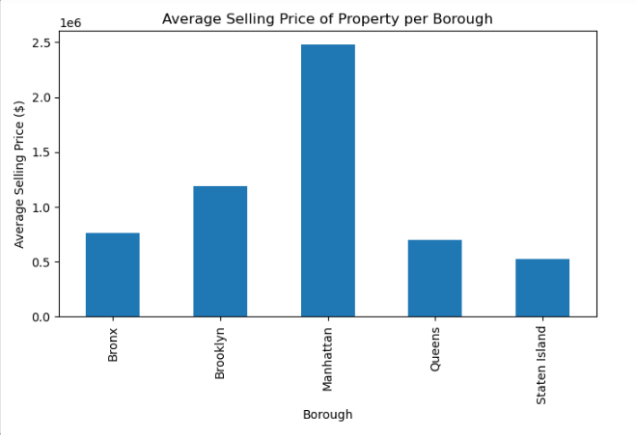
Average Property Selling Price Per Borough
Manhattan has the highest average selling price for properties, which aligns with its reputation as one of the most expensive real estate markets in the world.
Brooklyn follows Manhattan with a significant average selling price.

Slide 14
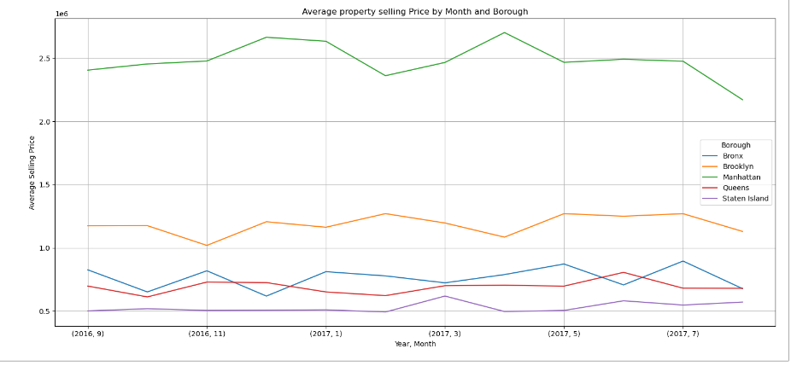
Average property Selling Price by Month and Borough
Manhattan property prices seem to peak around the middle of the year (around June) and then decline towards the end of the year.
Brooklyn prices remain relatively stable throughout the year with slight peaks around the mid-year.
Note: Not a general assumption, inference based on available data

Slide 15
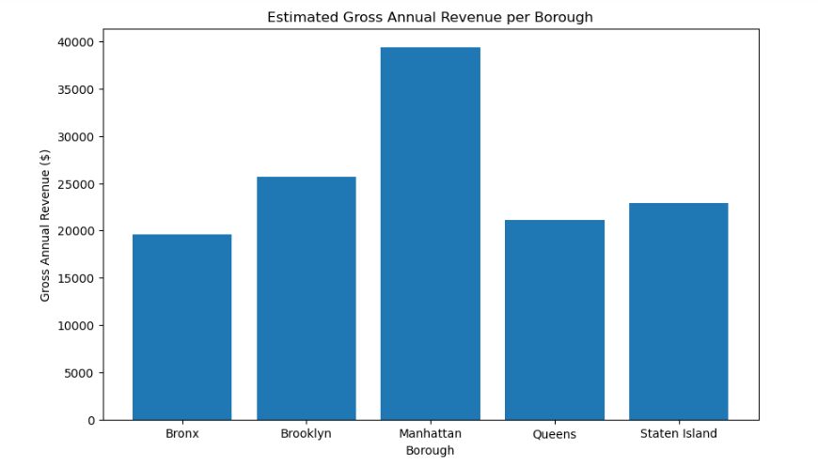
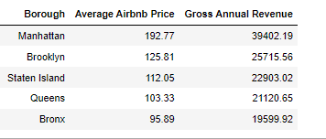
Estimated Gross Annual Revenue Per Borough
Manhattan and Brooklyn shows the highest gross annual revenue (estimated) which indicates good investment opportunity.

Slide 16
RECOMMENDATIONS
Below Recommendation can be made from the analysis
Manhattan and Brooklyn emerge as the prime choices.
High Demand
Top Rental Rates:
Appreciation Potential
"Entire home/apt" listings are the most lucrative:
Popularity:
Premium Pricing
Conclusion: An Entire home/apt property type in Manhattan and/or Brooklyn appears as the best investment option for the company.

Slide 17
RECOMMENDATIONS (Contd.)
Other Option: Queens
Market Approach
Pricing (Promo/Discounts)
Location Collaboration
Local Attraction

Slide 18
LIMITATIONS
Assumptions & Guesstimate – Data Quality & Integrity
Inadequate historical data – Seasonality, Trends & Patterns
External Factors – Government Policy, Security

Slide 19

Thank You For Listening… I welcome any questions you may have

